Slide 1
Quiet-window profiling for capsules
Profile each Capability Capsule alone on the GB10, test a few pairs, and use the records for planning and model routing
Workload profiling: evidence, gaps and decisions
Notes:
TIME 0:20
SAY: Main points:
- The case for profiling each capsule alone on the DGX Spark and keeping a record
- Then testing whether those records predict the busy runs, with stop rules

Slide 2
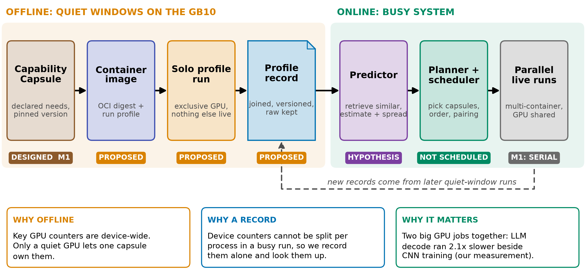
THE PROPOSAL
Profile alone, test pairs, see if it predicts busy runs
gb10-profiling-plan.md; planner seam: design-package/reference/run-plan.md:645
2
Notes:
TIME 1:30
SAY: Main points:
- Offline: a pinned container runs one capsule on an idle GB10 and we record everything
- The record joins the capsule version, image digest, machine state and measured outcome
- A small pair matrix tests whether solo records predict the busy runs
- Status chips are honest: only the declaration exists in M1, the rest is proposed
- Device counters cannot be split per process, so they are recorded alone and looked up
Supplemental points:
- The sidecar benchmark runner does not authorize this profiler (D36, D40)
- The end goal is bottleneck prediction for AI4Research and later chip questions

Slide 3
WHERE IT APPLIES
Where GPU contention can occur in AI4Research
Capsules | Where the work runs | GPU declared | Contention case
Intent, requirements, planner, search, screening, hypothesis, evaluation, delivery, verifier | Fixed Codex CLI route: remote model | None | None locally. Wall time is remote wait
research.builder | Codex CLI plus the POC code it runs in its workspace | None (poc_workspace write) | Depends on the experiment it writes: unmeasured
research.benchmark | Local tool on the GB10 | gpu_device exclusive, wall_s 3600 | Never paired by declaration. Peak memory measured at first pilot
Later | Local models behind the router, parallel branches (outside M1 per planner.md:216) | Per model and capsule | Pairing and model residency: the case for this deck
Likely M1 answer: the bottleneck is remote Codex wait, which GPU profiling cannot predict. Test 0 checks: trace one real run into remote wait, CPU, local GPU, I/O
design-package/1-system.md (fixed Codex route), reference/examples/*_capsule.json, capsules/research-benchmark.md:29, capsules/builder.md:36
3
Notes:
TIME 1:15
SAY: Main points:
- In M1 every capsule runs through the fixed Codex route, so most wall time is remote model wait
- Only the benchmark capsule declares a GPU, and it is exclusive, so it is never paired
- The builder runs experiment code whose GPU use we have not measured
- Pairing and model residency become real only with local models and parallel branches, which planner.md:216 puts outside M1
- If local GPU time is under about 10% of a real run, the case narrows to routing and experiments
Supplemental points:
- Resource facts come from the example declarations in the design package

Slide 4
WHY QUIET WINDOWS
Device counters cannot be split; most else can
Tool | Scope | Split per process under sharing? | Limit
nvidia-smi / NVML | device, process list | Memory per process yes. Per-process utilization only where pmon supports it (preflight) | No kernel or pipe detail. GB10: Memory-Usage Not Supported
DCGM profiling | whole device | No: SM, tensor, DRAM are device-wide | 1 Hz default, conflicts with Nsight. GB10 support is a preflight
DCGM job stats, MIG | per PID or job, per instance | Partly. Sampled. MIG on GB10 unknown | Preflight on the Spark
Nsight Systems | process timeline | Yes, but kernel durations include time the GPU spent on others | Intrusive, timing-only runs stay separate
Nsight Compute | per kernel | Per kernel, but replay is not a shared run | Replay perturbs the run
cgroup v2 + PSI | per container | Yes | Host resources only
The SM, tensor and DRAM counters need the GPU alone. Process memory and cgroup data split under sharing. Kernel times split too, but inflated by time spent on others
NVIDIA DCGM user guide (feature overview); DGX Spark known issues; gb10-profiling-plan.md:29-31; report.md:285-287
4
Notes:
TIME 1:15
SAY: Main points:
- DCGM says its profiling counters are device-level and conflict with Nsight
- Per-process memory and kernel timelines survive sharing, but kernel durations include time the GPU spent on others (report.md:286)
- So the quiet window is for SM, tensor and DRAM counters, not for everything
- DCGM job statistics and MIG might give more attribution, the Spark preflight decides
Supplemental points:
- Clouds attach pod labels to DCGM metrics, but the counters stay device-wide

Slide 5
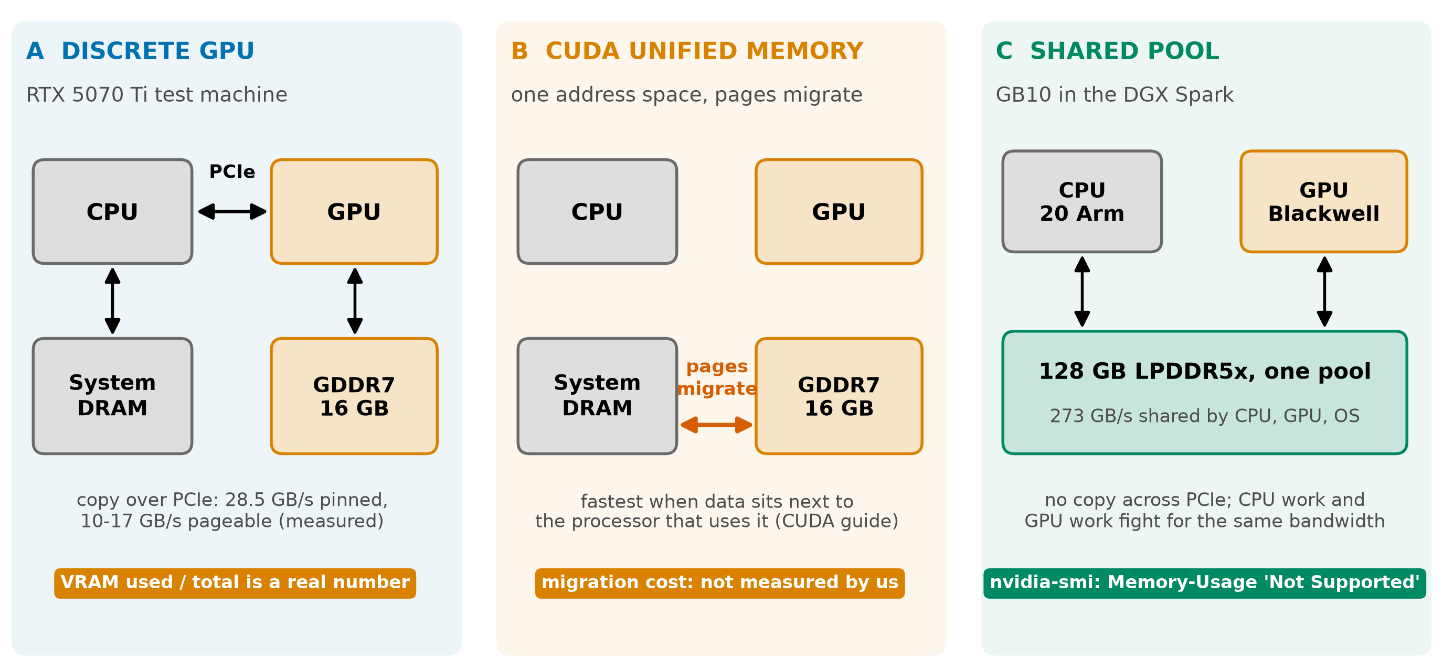
DGX SPARK
On GB10 the GPU shares one pool and dashboards go blind
NVIDIA DGX Spark hardware and known-issues pages; NVIDIA CUDA programming guide, Unified Memory section; copy speeds: Our measurements, RTX 5070 Ti, n=2 to 12, unaudited: sources/2026-10-16-shared-gpu/report.md
5
Notes:
TIME 1:15
SAY: Main points:
- Discrete card: VRAM is a number and PCIe copies are measurable
- Unified Memory on a discrete card migrates pages on demand, we did not measure its cost
- GB10: 128 GB LPDDR5x at 273 GB/s shared by CPU, GPU and OS
- NVIDIA documents nvidia-smi Memory-Usage as Not Supported on iGPU, read MemAvailable instead
- Our numbers come from the discrete card and do not transfer
Supplemental points:
- Cross-machine differences cannot be credited to unified memory alone

Slide 6

OUR MEASUREMENTS
LLM decode ran x2.08 slower beside CNN training (n=2)
• LLM decode x2.08 beside CNN training (x1.7 to x2.4 over two runs), x2.27 beside another LLM (n=8)
• Training slows only x1.16: long kernels hold the GPU
• Speech-to-text and NVENC stay between x0.98 and x1.12
• Pair choice matters. The planner slide tests whether a label is enough
• n=2 per pair except LLM+LLM. n/a = not run
Our measurements, RTX 5070 Ti, n=2 to 12, unaudited: sources/2026-10-16-shared-gpu/report.md (Fig. 6, table B.2)
6
Notes:
TIME 1:00
SAY: Main points:
- Four task types, every pairing, each compared with its own solo run
- LLM decode issues very short kernels, median 2.5 microseconds, with pauses between tokens
- It loses its turn to long training kernels
- Spread between runs is large for LLM beside training: x1.7 to x2.4 over two runs
Supplemental points:
- Model size, context and batch for the pair runs are not stated in the report

Slide 7
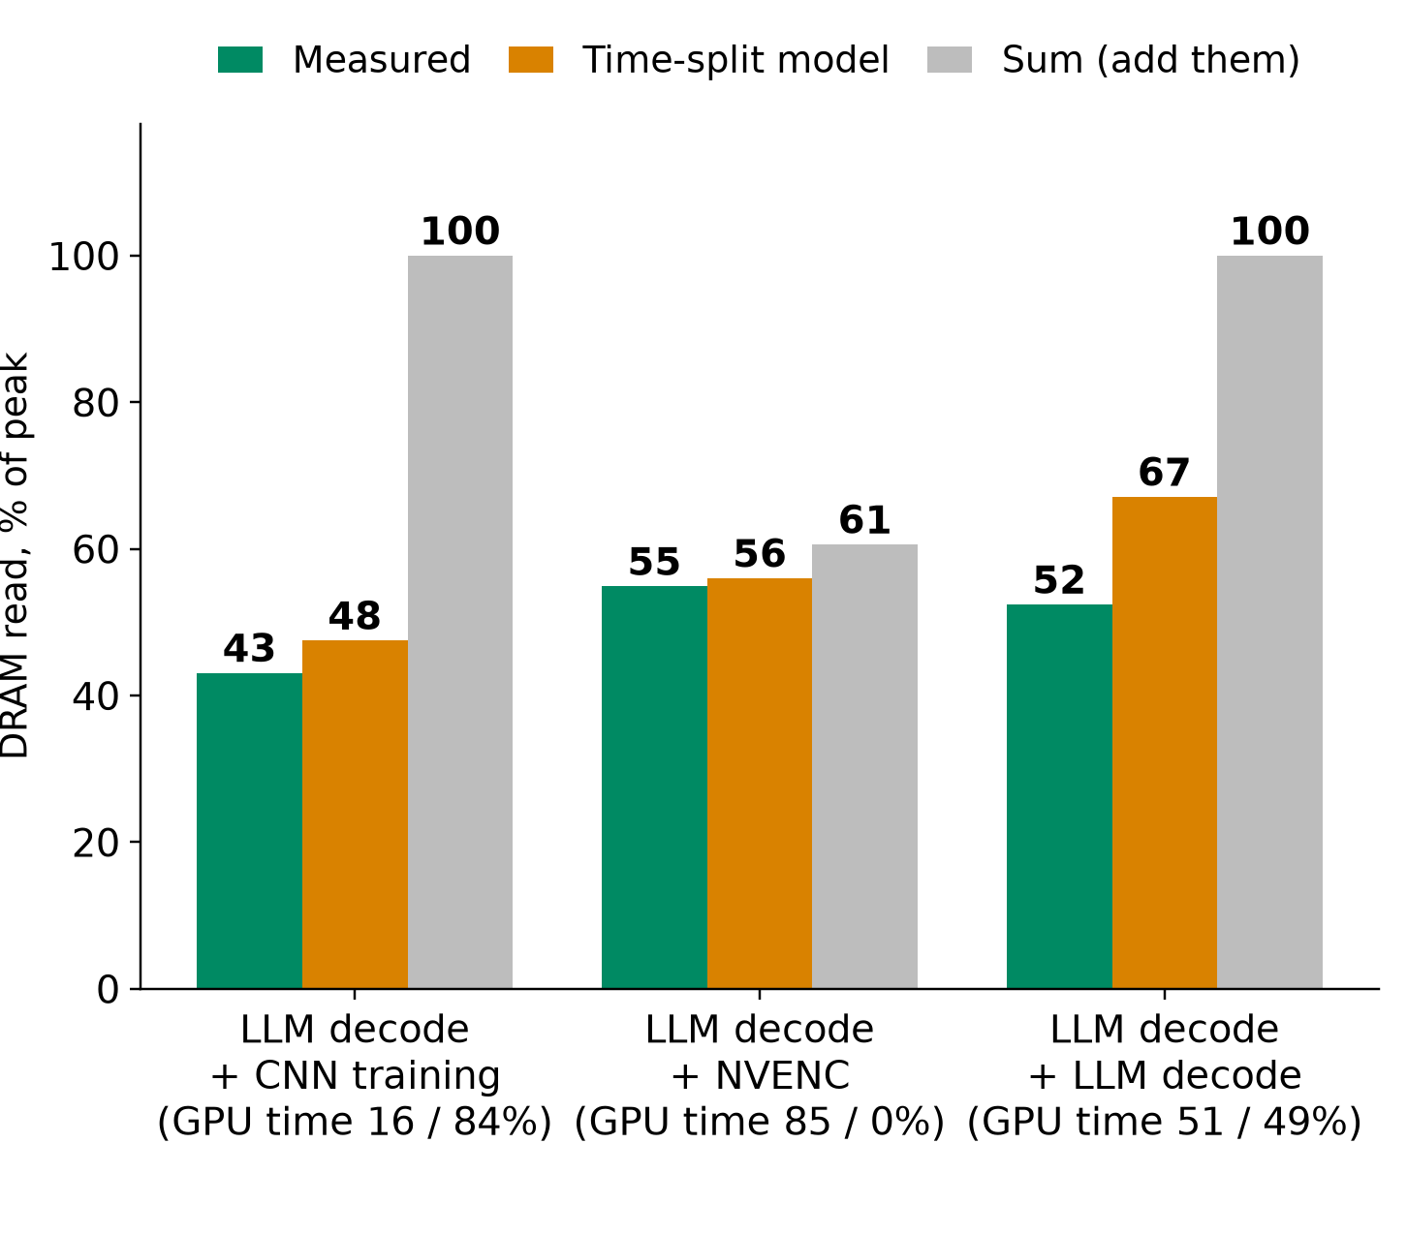

OUR MEASUREMENTS
Time-split is off by 2 to 22% on three pairs, given co-run shares
4 separate: 258 tok/s. Batched: 614. Memory 8.9 vs 2.5 GiB. Batch 8 is faster per token than 4 (n=2): recheck
Time-split needs co-run time shares: it explains, not predicts. Share is not slowdown (16% share, x2.08, not x5.7)
Our measurements, RTX 5070 Ti, n=2 to 12, unaudited: sources/2026-10-16-shared-gpu/report.md (Fig. 2, 3, 4; tables B.1, B.6). DRAM read only. MPS not tested
7
Notes:
TIME 1:15
SAY: Main points:
- Left: DRAM read bandwidth of A+B measured, from the time-split model, and from summing
- Time-split is close, but its inputs are the time shares, which only exist after the co-run
- The 2 to 22% switching loss is the leftover, computed on DRAM read only
- Right: qwen2.5 3B, 256 tokens, separate processes lose to batching
- NVIDIA MPS exists to cut context switching and GKE offers it, we did not test it
Supplemental points:
- Other counters differ: SMs active for LLM+LLM is 21% off, DRAM write is negative

Slide 8
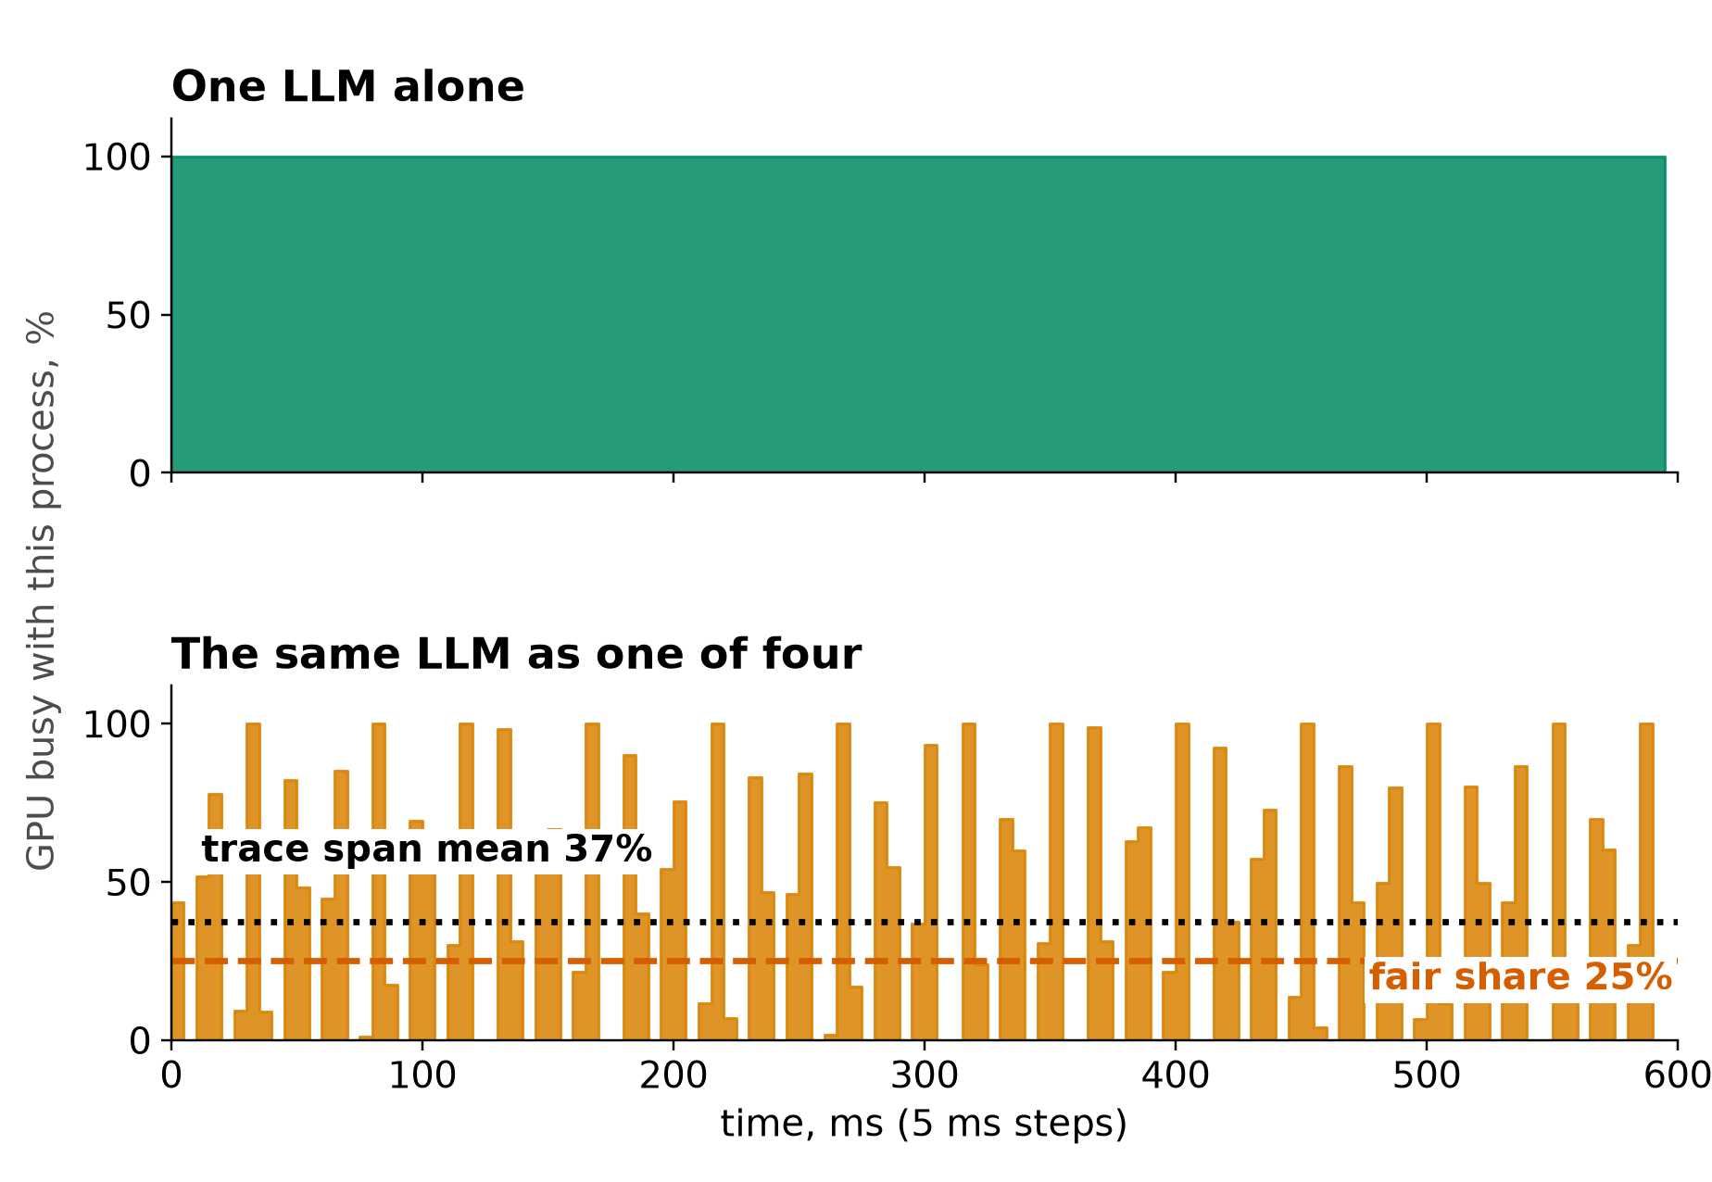
OUR MEASUREMENTS
Four LLMs together make 91% of one alone
• Alone: trace span 100%, 3.5 ms per token
• One of four: span averages 37%, flickers 0 to 100% every 5 ms, 15.8 ms per token
• Span includes time switched out. Useful throughput per stream: 22 to 26% of solo, 91% in total
• Total output: 4 processes 258 tok/s vs one 284. A loss, not a split
• Device busy is a different metric: solo 3B decode reads 91%
Our measurements, RTX 5070 Ti, n=2 to 12, unaudited: sources/2026-10-16-shared-gpu/report.md (Fig. 7, table B.1; 63.4 of 283.5 tok/s). Discrete card: the cost may differ on unified memory
8
Notes:
TIME 1:00
SAY: Main points:
- One of four identical LLM processes, kernel trace, 600 ms in 5 ms steps
- The trace reads 37% because a kernel's span includes time it was switched out
- Mean stream makes 63.4 of 283.5 tokens per second, which is 22% (range 22 to 26%), and the four total 91% of one alone
- Each token takes 4.5 times longer and the four together make less than one alone
- Discrete RTX 5070 Ti, not evidence about unified memory
Supplemental points:
- Trace span and device busy are different metrics: 100% alone against 91%

Slide 9

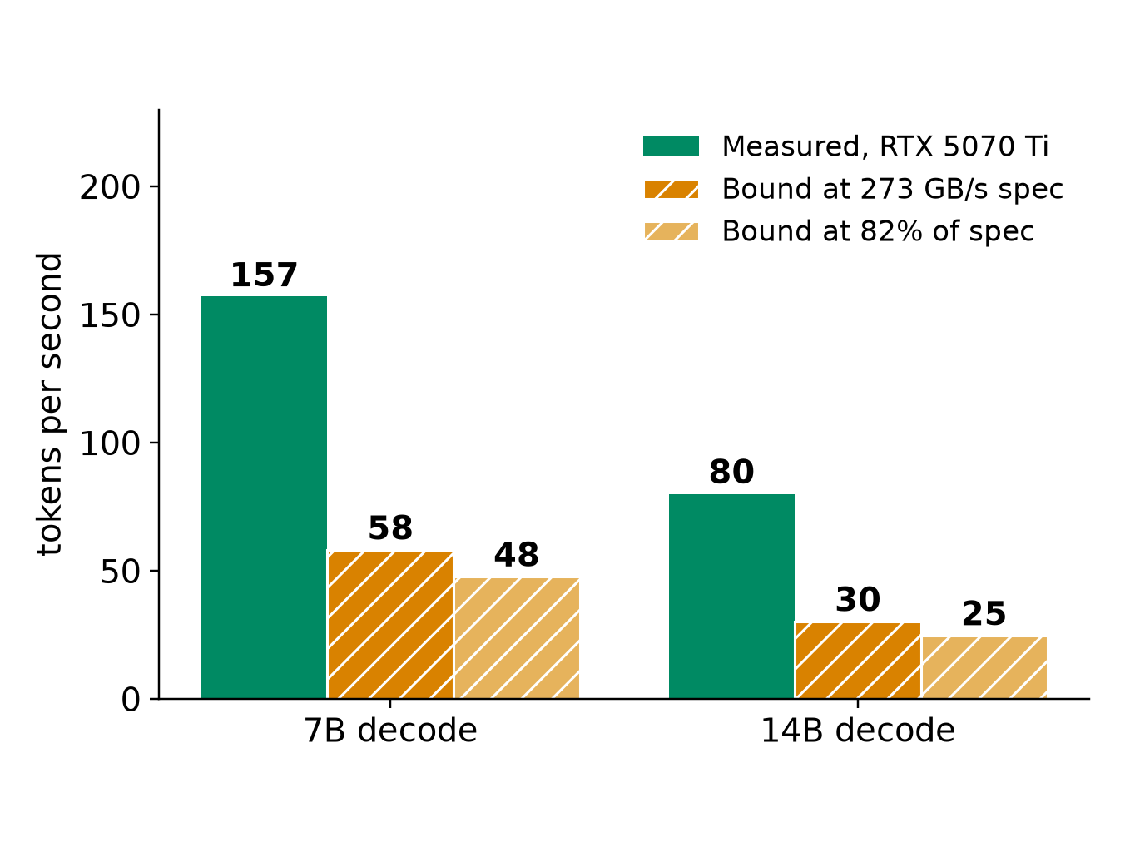
MODEL ROUTING
Router hypothesis: few resident models, one batching server
Each copy takes its own weights. On the GB10 they come out of the pool the experiments also use
Bound assumes bandwidth-bound decode and no CPU traffic. MoE differs (qwen.code30b: 3.3B active)
Hypothesis: few resident models plus batching. Quality is not measured here. Cold load: 6.1 s vs 0.05 s (7B)
Our measurements, RTX 5070 Ti, n=2 to 12, unaudited: sources/2026-10-16-shared-gpu/report.md (B.1, B.3, B.8). Bytes per token = model file size = decode GB/s over tok/s. Bound = arithmetic at the 273 GB/s GB10 spec, not measured
9
Notes:
TIME 1:15
SAY: Main points:
- Left: 4 separate processes held 8.9 GiB, batching 4 requests held 2.5 GiB
- Right: 7B decode reads 4.7 GB per token, so 273 GB/s allows at most about 58 tok/s, 14B about 30
- At the 82% efficiency the 5070 Ti reached, about 48 and 25
- Weights share the pool with experiments, so fewer and smaller models leave room
- Routing is behind RouterPort with a fixed route today, this is input for later phases
Supplemental points:
- Batching raises total tokens per second above these bounds because weights are read once per batch
- The model catalog includes an MoE model, so bytes per token is not always file size

Slide 10
WHAT YOU CAN SEE
Checking GPU load: AWS vs DGX Spark
Platform | How you check | What you see | What you cannot isolate
AWS EC2 | CloudWatch agent, nvidia_gpu block | nvidia_smi_utilization_gpu (share of time kernels ran), memory, PCIe, encoder | Which process or model caused the load
AWS EKS | Container Insights, DCGM exporter add-on | node_gpu_utilization, node_gpu_memory_utilization, pod_gpu_utilization | Bandwidth or SM share between pods on one GPU
AWS ECS | Container Insights, Managed Instances | GPU metrics per container, task, instance | Same: time-based, not per kernel
Google GKE | DCGM to Managed Prometheus | 21 metrics incl. tensor, FP, DRAM activity, labelled by pod | Kernel or instruction cause
DGX Spark | nvidia-smi, /proc/meminfo, DCGM if supported, Nsight | Per-process GPU memory. Pool via MemAvailable. Memory-Usage: Not Supported | Per-process bandwidth or SM share, a GPU-only memory number
Example: our four LLMs each ran 4.5x slower per token. A time-based utilization number does not show that
AWS CloudWatch GPU, Container Insights EKS and ECS docs; GKE DCGM metrics page; NVIDIA DGX Spark known issues; our report B.1
10
Notes:
TIME 1:15
SAY: Main points:
- Every cloud path gives device or pod level time-based metrics
- A slowdown from switching does not appear as lower utilization
- On the Spark the pool is read from the OS, GPU memory used and total is not available from nvidia-smi
- Per-process bandwidth and SM share are what we cannot isolate while others run
Supplemental points:
- DCGM profiling on GB10 is a preflight check, not assumed
- EKS enhanced observability needs add-on v6.0.1 or later for the OpenTelemetry path

Slide 11
CAVEAT
What may change on unified memory
Finding | Measured on discrete card | On the GB10 | Status
Decode is bandwidth-bound | 7B at 87 to 96% of measured ceilings | Ceiling lower, shared with CPU | Expected to carry over
Batching beats separate processes | 614 vs 258 tok/s | Same weight-reuse argument | Expected to carry over
CPU work takes GPU bandwidth | Not applicable, separate memory | Likely the main new interference | Untested
Process switching cost | 2 to 22% lost (DRAM read) | Needs remeasuring | Unknown
Model load, RAM vs GPU memory | 2.7 s vs 0.05 s first token | May converge, no PCIe copy | Unknown
Partial CPU offload | 157 to 22 tok/s at 20 of 28 layers | PCIe cliff goes away | Unknown
Memory accounting | 16 GB dedicated. File cache charged to the first container that reads it | 128 GB shared. Whether cgroups see GPU allocations is unproven | Unknown
Our measurements, RTX 5070 Ti, n=2 to 12, unaudited: sources/2026-10-16-shared-gpu/report.md, Limits section; NVIDIA DGX Spark hardware and known-issues pages. Nothing here is measured on a GB10
11
Notes:
TIME 0:45
SAY: Main points:
- Everything measured so far is x86 with a separate GPU over PCIe
- Shapes of bandwidth-bound decode and batching should carry over, absolute numbers will not
- CPU work competing for GPU bandwidth is the main new effect and has no test yet
- Switching cost, load times and offload need a GB10 run before anyone relies on them
Supplemental points:
- Cross-machine differences cannot be credited to unified memory alone

Slide 12
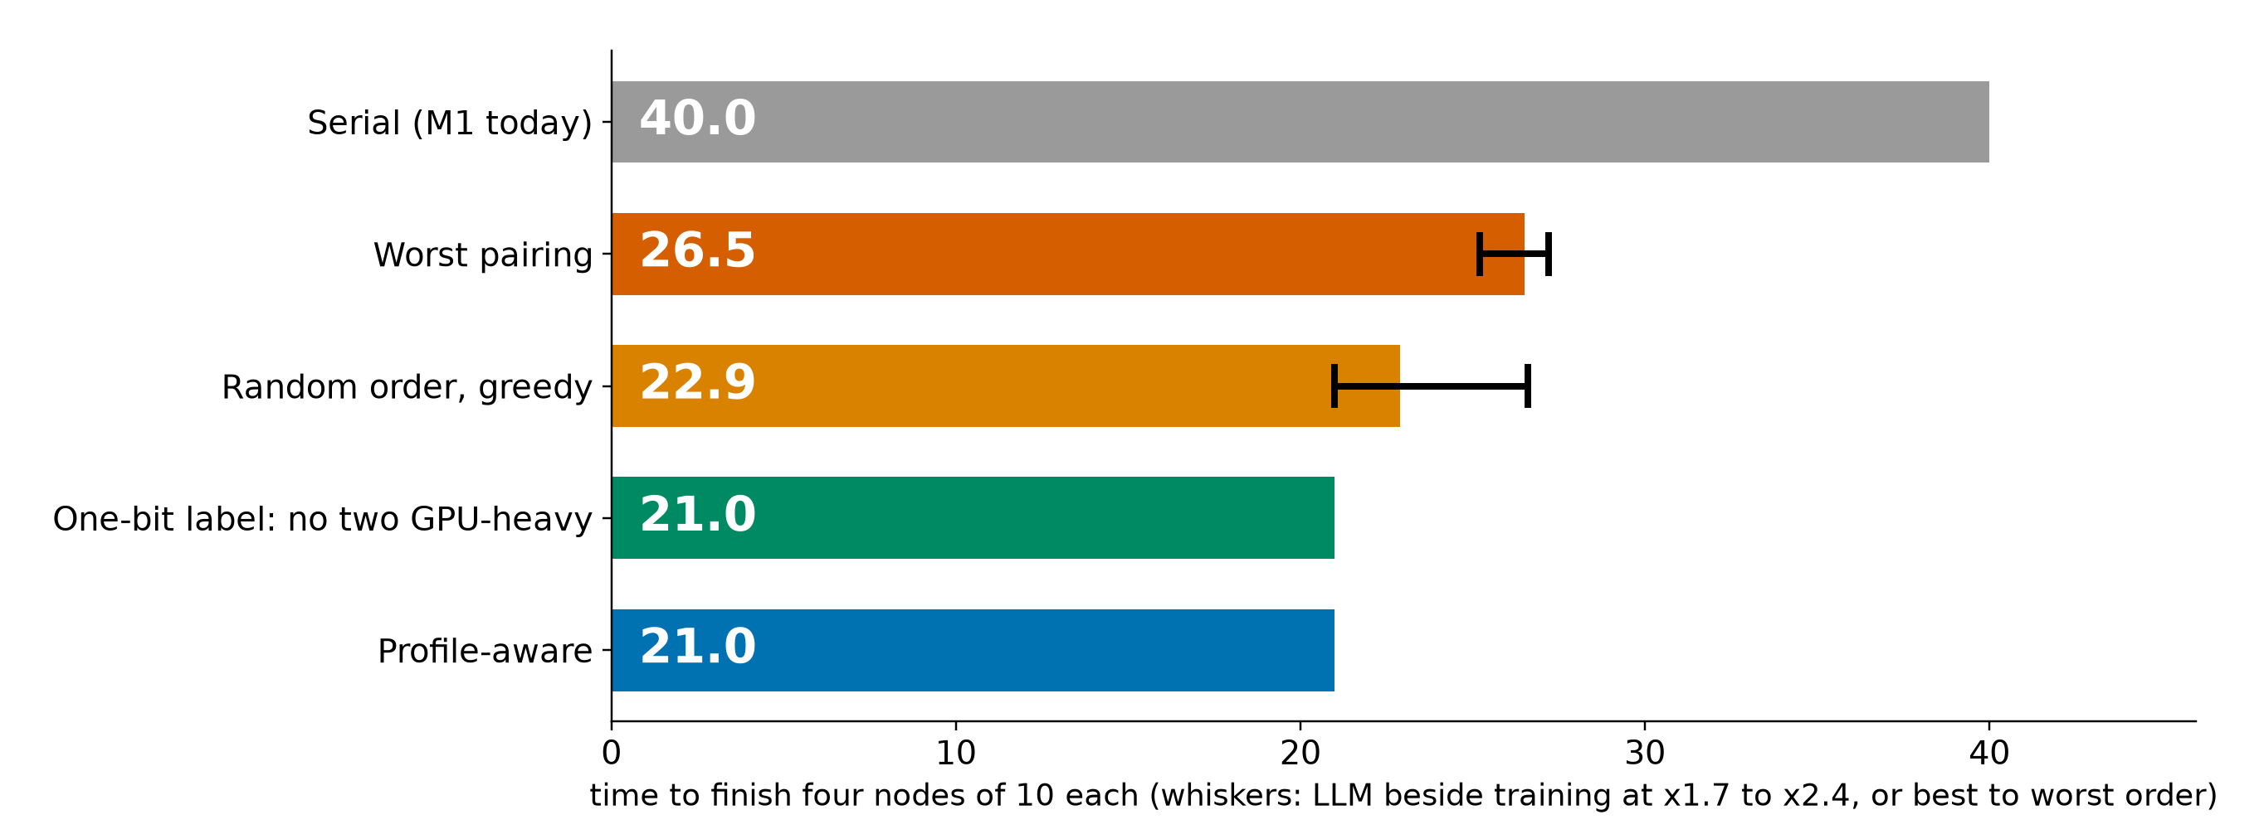
PLANNER IMPACT
Toy case: pairing 21.0 vs 26.5 worst; a label finds it
• A one-bit label (no two GPU-heavy) already matches profile-aware here, if each node's class is known: declared, or from one solo profile
• Profiles earn their cost with many GPU-heavy classes, and for memory and routing
• M1 runs one node at a time. Parallel nodes stay outside M1 (planner.md:216)
planner_baselines.py: fluid model, two slots, four nodes of 10, our n=2 pair slowdowns (RTX 5070 Ti, unaudited)
12
Notes:
TIME 1:15
SAY: Main points:
- Four nodes of equal length, A LLM, B training, C speech, D NVENC, at most two run at once
- Worst pairing 26.5, random order about 22.9, best 21.0, serial 40
- A one-bit GPU-heavy label picks the best pairing without any profile
- So the planner case for profiles is many classes, memory limits and routing, not this toy. Parallel nodes are outside M1
Supplemental points:
- Whiskers: LLM beside training at x1.7 to x2.4 moves the worst pairing from 25.2 to 27.2
- Orion (EuroSys 2024) co-schedules kernels by complementary resource use

Slide 13
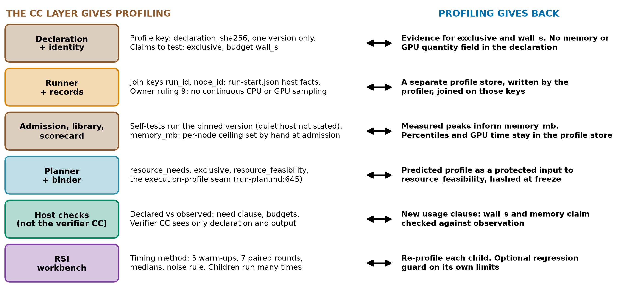
THE CAPSULE LAYER
The CC layer and profiling feed each other
design-package/reference/declaration.md, reference/derived-records.md, reference/run-plan.md:645, checking/README.md:29, side-systems/rsi-workbench.md:174
13
Notes:
TIME 1:30
SAY: Main points:
- The declaration identity, declaration_sha256, is the profile key, so a profile belongs to one version
- The runner already records host facts and null-never-zero measurements, profiling adds nullable fields
- Admission self-tests are solo pinned runs, memory_mb is the only resource number and it is a placeholder today
- The planner has the execution-profile seam, a prediction needs a new protected input
- Host checks can compare declared with observed, the verifier capsule cannot since it sees only declaration and output
Supplemental points:
- The declaration can name gpu_device exclusive and has wall_s, but no memory or GPU quantity field
- RSI timing: 5 warm-ups, 7 paired rounds, medians, more than 3x calibrated noise

Slide 14

WHERE IT ATTACHES
Where a profile attaches, and where it must not
design-package/reference/run-plan.md:74-80,191,645; reference/declaration.md:41; development-tools/sidecar/README.md:103,107; side-systems/owner-rulings.md:123
14
Notes:
TIME 1:00
SAY: Main points:
- Five existing places cannot carry a prediction, each for a stated reason in the design
- The landing is a new protected input beside the resource inventory and plan policy, hashed at freeze
- Sidecar README line 107 says no profiling integration or product telemetry, and owner ruling 9 says no continuous CPU or GPU sampling in run capture. So this needs an owner decision
- The execution-profile seam is already named for parallel branches
Supplemental points:
- Sidecar launcher never pauses or preempts a core run

Slide 15
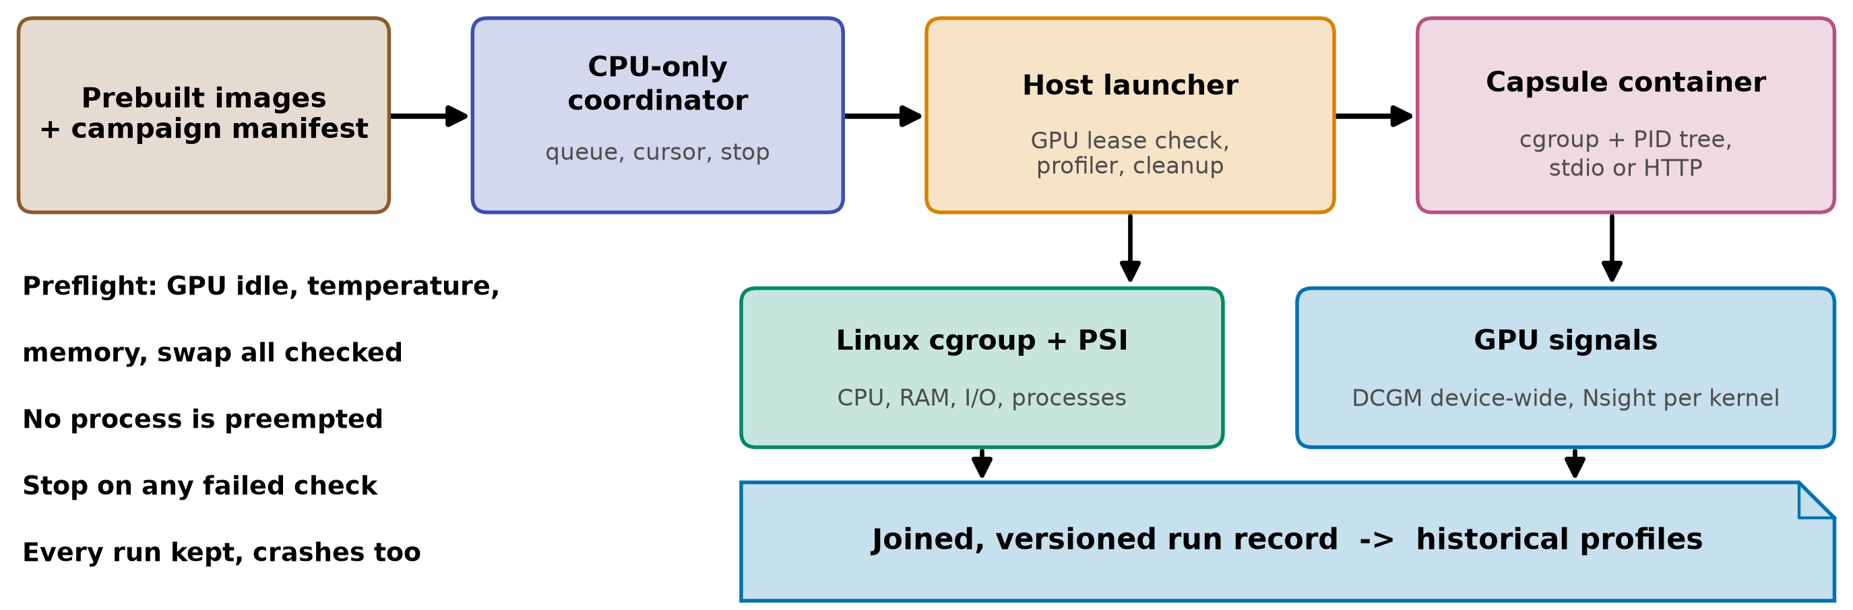
CONTAINERIZED CAPSULES
Proposed: pinned containers in a quiet window
The image gives us | It does not give us | Cost and constraint
Digest as executable identity, repeatable environment | Exclusive GPU, deterministic timing | +216 ms per GPU start (219 total); +245 ms with a 340 ms task
cgroup and PID-tree accounting | Kernel metrics scoped to the container | Window on the single product host (D35). Launcher never preempts
Same packaging unit as the Paper2Agent proposal | Any change to the capsule declaration | Sidecar README:107 excludes profiling integration today
gb10-profiling-plan.md; NVIDIA Container Toolkit; Slurm job arrays; sidecar/README.md:103,107; owner-rulings.md:123; startup: Our measurements, RTX 5070 Ti, n=2 to 12, unaudited: sources/2026-10-16-shared-gpu/report.md
15
Notes:
TIME 1:15
SAY: Main points:
- Containers do not make GPU counters per container, the quiet window does
- Prebuild images, run serially, stop on any failed preflight, never preempt a running job
- The GB10 is the only M1 product host, so a window is a scheduling decision
- Keep the Docker socket out of the capsule, the host launcher owns profiler and cleanup
Supplemental points:
- arm64 and amd64 images are different environments and are recorded separately
- AGX Orin study (HiPC 2023) found small container overhead for its setup, so we measure ours

Slide 16
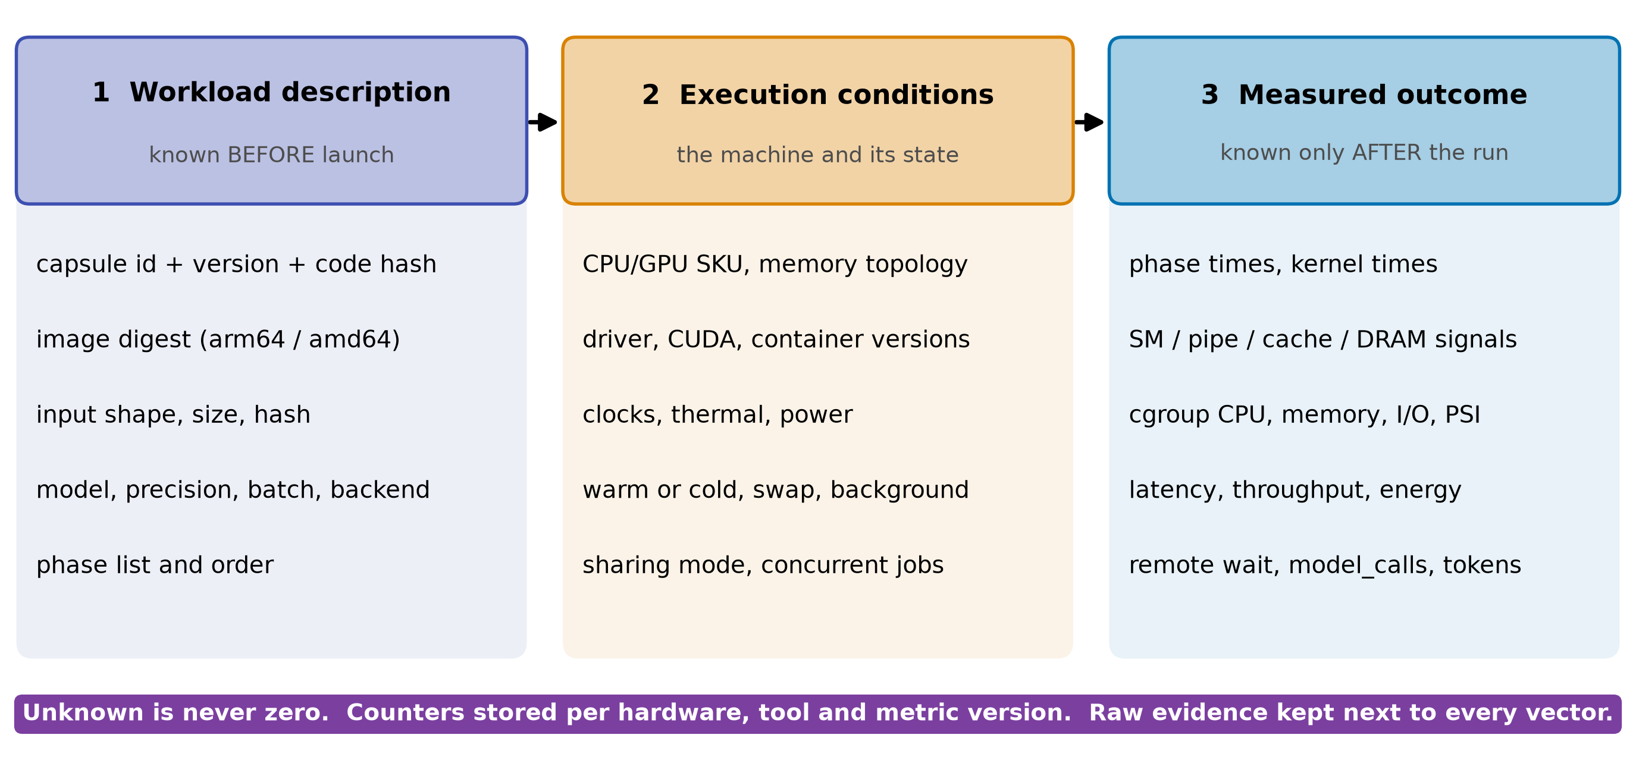
THE RECORD
Three linked records, versioned like the capsule
• Invalidate on: new declaration_sha256, image digest, driver or firmware change
• RSI child: inherits memory_mb, not its profile. Re-profile before use
• Unprofiled capsule: unknown, never zero. Planner falls back to declared exclusive or serial
gb10-profiling-plan.md, future data contract; design-package/reference/declaration.md (declaration_sha256), side-systems/rsi-workbench.md
16
Notes:
TIME 1:00
SAY: Main points:
- Description is known before launch and is the only input to pre-launch prediction
- Conditions describe the machine, counters are stored per hardware and tool version
- Outcome is after the run and never an input to the same run's prediction
- A new capsule version is a new identity, so its record starts empty
Supplemental points:
- Start with nearest neighbor on understandable features, preserve phase order
- Chakra is a training-trace format, reuse only what maps to capsule phases

Slide 17
THE TEST
How we would test that solo profiles predict pairs
Claim | Inputs allowed | Test | Pass if
1 Before launch | Solo features only: kernel median, GPU busy, launch rate, plus DRAM and tensor % if test 1 finds them | Leave one task family out, predict pair slowdown | Beats B0 and B1 on slowdown error and pairing choice, by more than the repeat spread
2 After a short prefix | Plus a bounded profiling run | Same split, report profiling cost | Error falls enough to pay for the prefix
3 Changed hardware | Plus a hardware model | Not tested here | Needs a calibrated simulator
• Baselines: B0 no interference (x1). B1 one-bit GPU-heavy label. B2 nearest neighbor. Time-split with measured shares is an upper bound, not a predictor
• Spread first: LLM beside training varied x1.7 to x2.4 over two runs, so no error target below that is testable. Measure repeat variance, then the planner owner sets the target. Only 4 task families exist today: leave-one-out is a feasibility check, not a statistical test
• Stop rule: if B1 matches on pairing, ship the label and keep profiles for memory and routing
literature/README.md (NeuSight ASPLOS 2025, Orion EuroSys 2024, SoCC 2025); plan Phase D; Our measurements, RTX 5070 Ti, n=2 to 12, unaudited: sources/2026-10-16-shared-gpu/report.md
17
Notes:
TIME 1:15
SAY: Main points:
- Three separate claims, never mix a finished run's counters into a pre-launch prediction
- Hold out whole task families and hardware, not repeats of the same run
- Baselines include a one-bit label because the planner example showed it can be enough
- The program has a stop rule, so the funding ask has an exit
Supplemental points:
- The error target is not set: it must exceed the repeat spread
- SoCC 2025 (Elvinger et al.) gives resource-specific sensitivity methods we can reuse

Slide 18
CHIP QUESTIONS
From profiles to chip questions
Question for a chip team | Controlled change on the GB10, if exposed (preflight) | Measured | Output
How much does bandwidth matter? | Working-set and context sweeps; memory clock if exposed | tok/s vs bytes moved | Slope with interval
How much does compute matter? | Power cap, GPU clock, MPS thread percentage as an SM proxy | Latency per kernel class | Slope with interval
Where is the capacity cliff? | Model and KV size within the 128 GB pool | Residency, swap events | Cliff location
Does CPU work take GPU bandwidth? | CPU streaming job beside decode | tok/s, DRAM activity | Slowdown curve
What do agent workloads look like? | Replay real capsule traces: bursts, tool waits, model swaps | Timelines | Duty cycles
Can a simulator stand in? | Calibrate Accel-Sim on the baseline, Chakra traces as input. Unified-memory fidelity unverified | Sim vs measured | Accepted only inside a stated error
gb10-profiling-plan.md:14 (a bottleneck claim needs a controlled change); Accel-Sim ISCA 2020; Chakra 2023; none of this has been run
18
Notes:
TIME 1:00
SAY: Main points:
- Solo records on one chip cannot separate bandwidth from compute from capacity
- Each row needs a controlled change, which is what makes a bottleneck claim defensible
- Which knobs the GB10 exposes is a preflight question
- Agent traces matter because bursts and tool waits are not in our current tests
- The output chip teams can use is sensitivity with intervals per workload
Supplemental points:
- Decode being bandwidth-bound is already well known, the new content is the agent mix and the GB10

Slide 19
RECOMMENDATIONS
Five to do, five to avoid, each tagged
Do | Backed by | Avoid | Because
Profile solo in exclusive windows | DCGM profiling conflicts with Nsight (NVIDIA) | Per-container GPU shares from device counters | Counters are device-wide
Key records by declaration hash, image digest, machine | NVIDIA Container Toolkit, OCI; CC identity | Comparing percentages across chips | Utilization is not headroom
Keep phases: startup, cold, steady | Ours, 5070 Ti, GB10 pending: 64 s vs 5 s | One averaged vector per task | Averages hide peaks
Pair by resource class, test against a label | Orion; ours, 5070 Ti, GB10 pending: x2.08 vs x1.02 | Summing utilization | Time-split fits 3 pairs
Batch, do not clone, model servers | Ours, 5070 Ti, GB10 pending: 614 vs 258 tok/s; GKE offers MPS | Treating GB10 memory as VRAM | One pool, no VRAM counter
NVIDIA DCGM, MPS, Container Toolkit docs; Orion EuroSys 2024; GKE MPS guide; Our measurements, RTX 5070 Ti, n=2 to 12, unaudited: sources/2026-10-16-shared-gpu/report.md
19
Notes:
TIME 1:00
SAY: Main points:
- Every row names where it is used or measured, and which rows still wait on the GB10
- The avoid column is the failure modes from the literature and from our numbers
Supplemental points:
- Also avoid exhaustive combination sweeps and collecting every counter

Slide 20
NEXT
Tests in order, with gates and stop rules
# | Test | Decides | Gate or stop
0 | Trace one real AI4Research run: remote wait, CPU, local GPU, I/O | Whether local GPU matters | Under about 10% local GPU: drop pairing, keep routing
1 | Probe DCGM, Nsight, cgroup, MIG, job stats on the GB10. Check cgroups see GPU allocations | Which signals and memory accounting exist | No usable counters: keep timing, memory, cgroup
2 | Solo baselines: 5 synthetic cases (FP, tensor, DRAM stream, cache, launch-bound), then the benchmark capsule and one builder POC | Record fields, and whether synthetic cases transfer to capsules | GATE: go, narrow or stop. Synthetic cases are calibration only: real-capsule runs decide
3 | CPU memory-streaming job beside LLM decode on the GB10 | Main new UMA interference | None
4 | MPS vs time-slicing on the LLM plus training pair | Removable switching cost | None
5 | Pair matrix of the 5 synthetic classes on the GB10, then predictor hold-out. Same cases on the 5070 Ti | Whether profiles predict pairs | Stop rule on the test slide
6 | NVDEC and NVENC separated | Media-engine path | Optional
gb10-profiling-plan.md phases A to D; prebuild-recommendations.md
20
Notes:
TIME 1:00
SAY: Main points:
- Test 0 needs no GPU window and could end the pairing case early
- Tests 1 and 2 are the proposed first step, with a go, narrow or stop gate
- Sharing pairs come only after reliable solo profiles
Supplemental points:
- Set repeat counts from pilot variance, bracket with control runs for thermal drift

Slide 21
THE ASK
The ask: owner, sizing, gates, kill criteria
Item | Proposed (unmeasured estimate) | Note
Owner | To be named: GB10 campaign and record store | Needs a person, not a role
Test 0 | 1 to 2 days, no GPU window | One real run traced
Tests 1 and 2 | About 1 week: 5 synthetic cases x 3 passes x 5 repeats = 75 runs, about 12.5 GPU-hours at 10 min each. Real-capsule runs and the pair matrix are extra | Re-size from pilot variance
Quiet window | On the single product host (D35). Launcher never preempts | Idle-only or scheduled
Gate and kill | After tests 1 and 2. Stop rules on the test slides | Go, narrow or stop
Schema asks | Admission resource clause, usage clause kind, protected profile input. Reuse the benchmark runner hardware_inventory record. Add image digest to the join key | CC schema and planner owners
Sizing is a proposal, not a measurement. Constraints: development-tools/sidecar/README.md:103,107; method/decisions.md D35, D36, D40
21
Notes:
TIME 1:00
SAY: Main points:
- Asking for an owner and a first step of about a week, not a program
- Sizing is an estimate: 75 runs at about ten minutes each
- The quiet window costs us the product host for that time, so it needs a policy
- Schema asks go to the owners of the declaration and the planner
Supplemental points:
- Test 0 can run first with no GPU window

Slide 22
FUTURE
What decides go, narrow or stop
If we find | Then
Test 0: local GPU under 10% of a real run | Narrow to local-model routing and experiment capsules. No pairing work
Test 1: no usable counters on the GB10 | Stop counter profiling. Keep timing, memory and cgroup records
Predictor loses to the one-bit label | Propose the label as a declaration field. Profiles feed memory and routing only
Predictor beats the label on held-out pairs | Propose the protected profile input and admission clause, ahead of parallel branches
GB10 knobs give sensitivity curves | Start a chip-facing report: sensitivity per workload with intervals
future-path.md in this folder; stop rules from the test slides
22
Notes:
TIME 0:45
SAY: Main points:
- Each outcome has a decision attached, so the work cannot drift
- The cheapest test can narrow the whole program
- future-path.md lists the open decisions and the schema changes to propose
Supplemental points:
- Chip-facing claims wait on the controlled-change rows

Slide 23
Appendix
Clouds, GPU map, decode, startup, literature, limits, sources
Notes:
TIME 0:05
SAY: Main points:
- Backup material, shown only on request

Slide 24
APPENDIX
Clouds collect device metrics; labels need Kubernetes
Provider | Path | What it collects | Attribution
AWS | CloudWatch agent, nvidia_gpu block | nvidia_smi_* utilization, memory, temperature, PCIe, encoder stats | Instance level, needs driver and nvidia-smi
Google GKE | Managed DCGM to Managed Prometheus | 21 metrics: GPU util, SM, FP16/32/64 and tensor pipes, DRAM, PCIe, NVLink, power | container, pod and namespace labels on every metric
Microsoft AKS | DCGM exporter to Managed Prometheus and Grafana | Utilization, memory, temperature, power | Per scrape of GPU node pools
AWS CloudWatch agent NVIDIA GPU page; GKE DCGM metrics page; AKS monitor-gpu-metrics page
23a
Notes:
INSERT: optional slide; delete or hide it and the talk flows unchanged
TIME 0:30
SAY: Main points:
- Same device metrics everywhere
- Only Kubernetes labels give workload attribution

Slide 25
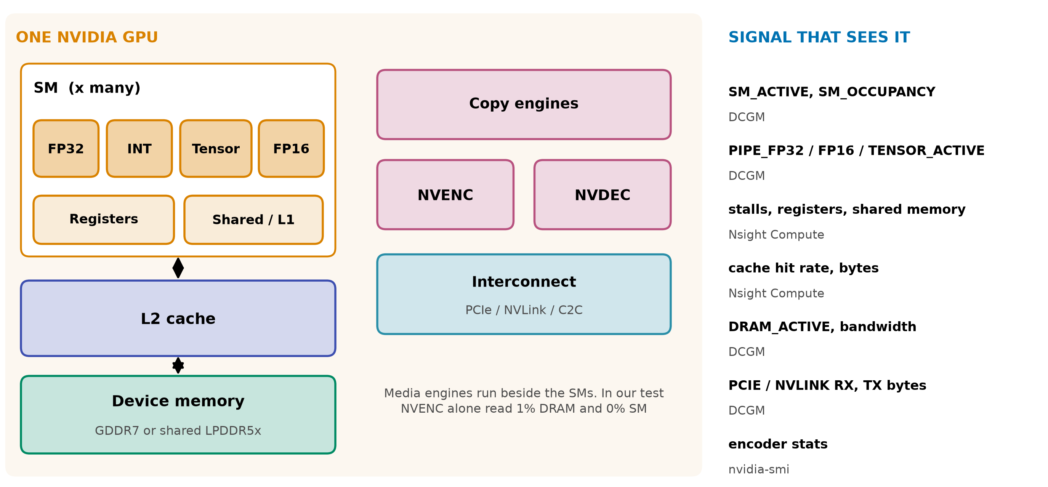
APPENDIX
Six GPU resources, six different signals
NVIDIA DCGM profiling fields; AWS CloudWatch encoder stats; NVENC read 1% DRAM, 0% SM: Our measurements, RTX 5070 Ti, n=2 to 12, unaudited: sources/2026-10-16-shared-gpu/report.md (B.5)
23b
Notes:
INSERT: optional slide; delete or hide it and the talk flows unchanged
TIME 0:30
SAY: Main points:
- Media engines run beside the SMs, in our test NVENC alone read 1% DRAM and 0% SM

Slide 26
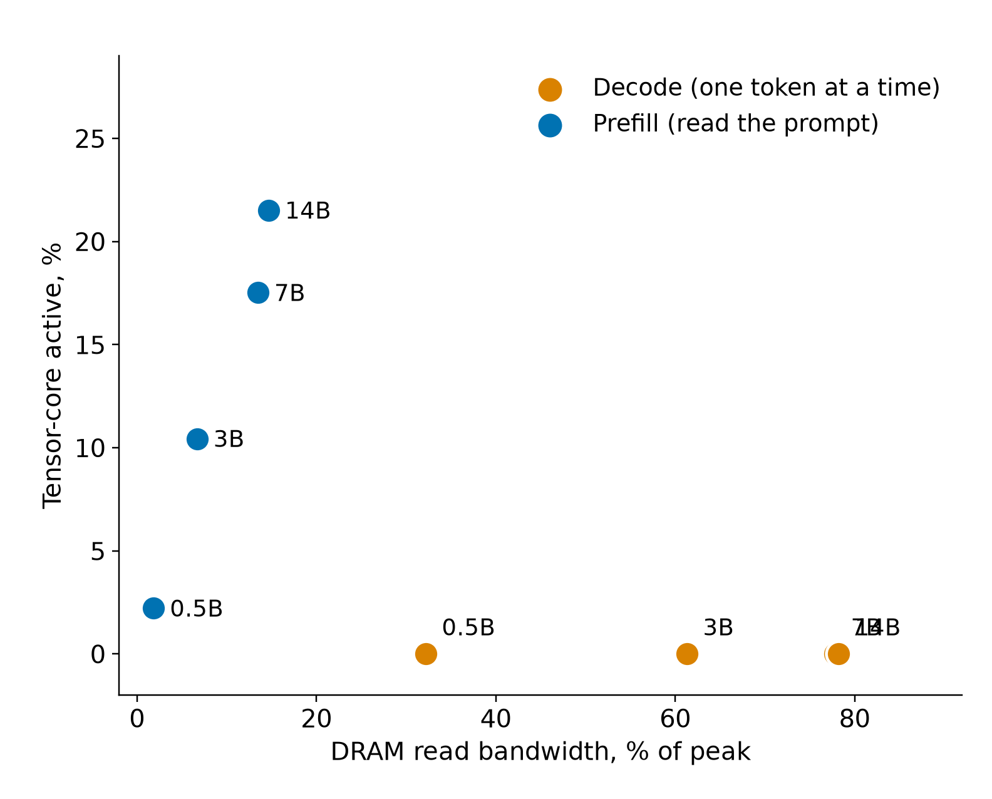
APPENDIX
Decode is memory-bound: 7B reaches 87 to 96% of ceilings
Model | Decode tok/s | Decode DRAM | Prefill tok/s | Prefill tensor
0.5B | 738 | 32% | 31,726 | 2%
3B | 283 | 61% | 10,709 | 10%
7B | 157 | 78% | 6,590 | 18%
14B | 80 | 78% | 3,397 | 22%
• Speech-to-text and NVENC: 0 to 3% on every counter
• 7B partial offload: 157 tok/s all-GPU, 22 at 20 of 28 layers
Our measurements, RTX 5070 Ti, n=2 to 12, unaudited: sources/2026-10-16-shared-gpu/report.md (Fig. 8, tables B.3 and B.5). Decode GB/s = model file bytes x tok/s; ceilings: 850 GB/s matrix-vector, 770 GB/s copy (B.7)
23c
Notes:
INSERT: optional slide; delete or hide it and the talk flows unchanged
TIME 0:30
SAY: Main points:
- Records need both memory and compute dimensions

Slide 27
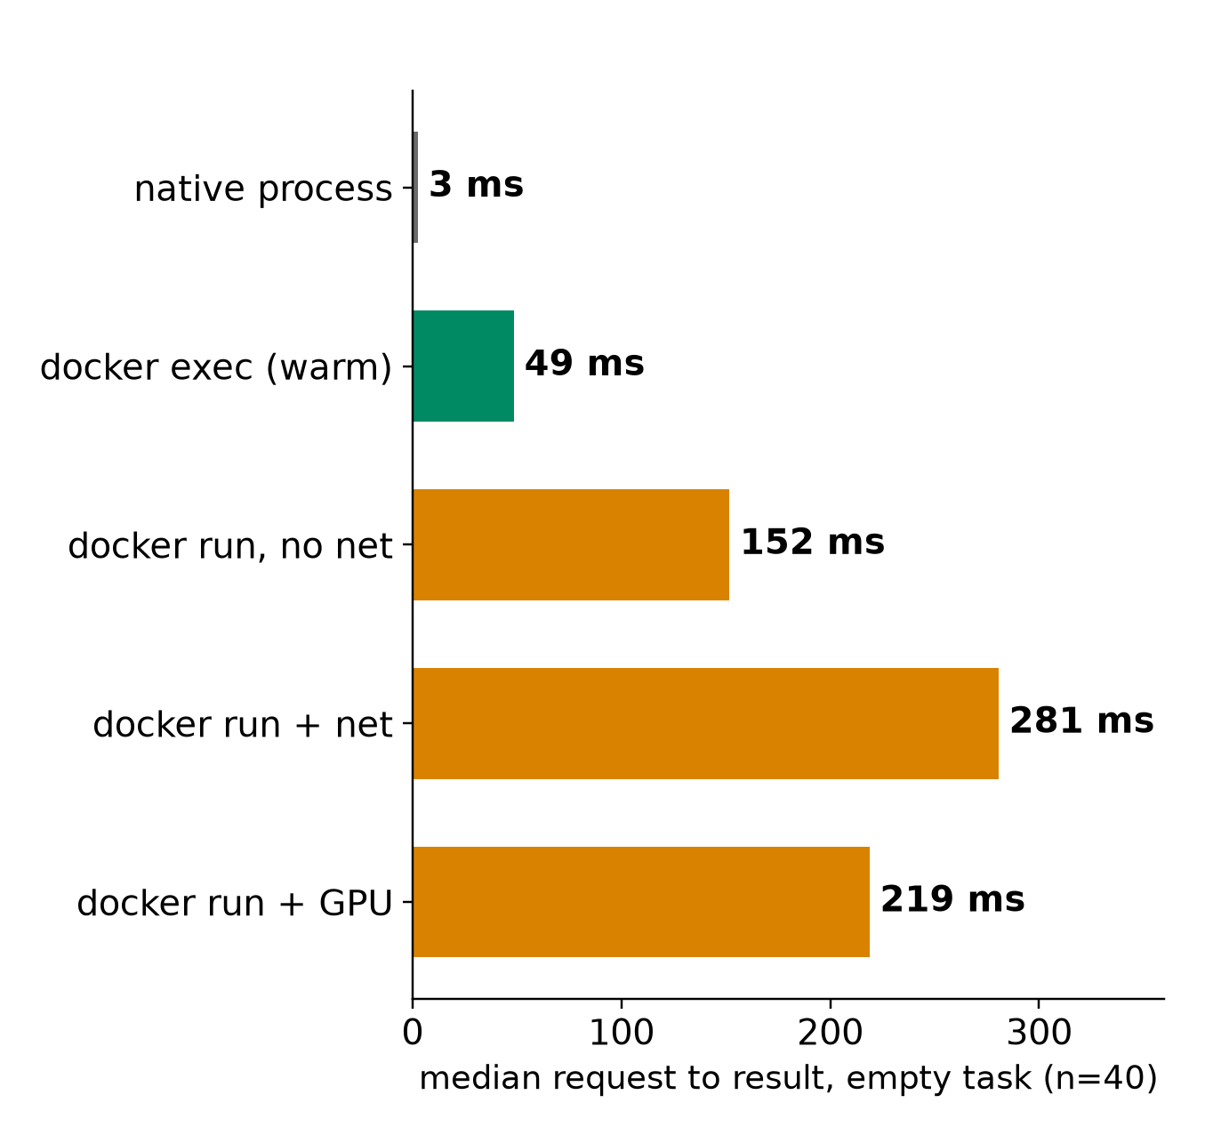
APPENDIX
Startup is its own phase: +216 ms, 64 s vs 5 s
• Overhead per GPU start: +216 ms empty, +245 ms with a 340 ms task
• 16 containers at once: about 2.8x slower each
• Fresh Ollama container: 64.4 s vs 5.3 s with a shared GPU-code cache
• 7B first token: 0.049 s loaded, 2.7 s in RAM, 6.1 s from disk
Our measurements, RTX 5070 Ti, n=2 to 12, unaudited: sources/2026-10-16-shared-gpu/report.md (Fig. 9 to 13, table B.8)
23d
Notes:
INSERT: optional slide; delete or hide it and the talk flows unchanged
TIME 0:30
SAY: Main points:
- Profile cold and warm separately and label which one a record is

Slide 28
APPENDIX
Prior work: what to reuse, what is still open
Prior work | Reuse | Still open here
Utilization prediction, HotCloud 2020 | Graph features, no per-job profiling | Coarse busy, not per component
NeuSight, ASPLOS 2025 | Tile-level latency across GPUs | Not stress for arbitrary tasks
Orion, EuroSys 2024 | Kernel profiles for sharing | Predicted, not measured, profiles
GPU Resource Interference One Level Deeper, SoCC 2025 | Resource sensitivity methods | Unseen tasks, agent mix
Accel-Sim, ISCA 2020; Chakra 2023 | Simulator; trace format | Calibration on our target
literature/README.md. Links on the source map
23e
Notes:
INSERT: optional slide; delete or hide it and the talk flows unchanged
TIME 0:30
SAY: Main points:
- Reuse code, datasets and trace formats before running new experiments

Slide 29
APPENDIX
What this evidence shows and what it does not
Shows | Does not show
Pairing, batching and cold start effects on one x86 plus RTX 5070 Ti machine | Anything about the GB10 or unified memory
Time-split fits DRAM read on three pairs | That it predicts, or that MPS removes the switching cost (not tested)
Decode is bandwidth-bound across 0.5B to 14B | Prediction accuracy: no predictor built or held out
Container start +216 ms with GPU | Chip-design conclusions: no sensitivity runs
Repeats are small (2 to 12), raw traces and ledger stay on the other machine | NVDEC, NVENC subtitle path, real agent traffic, how much of a real run is local GPU
Our measurements, RTX 5070 Ti, n=2 to 12, unaudited: sources/2026-10-16-shared-gpu/report.md
23f
Notes:
INSERT: optional slide; delete or hide it and the talk flows unchanged
TIME 0:30
SAY: Main points:
- Everything here was imported from the measuring machine and not independently audited

Slide 30
APPENDIX
Source map
Claim | Source
DCGM device-level profiling, 1 Hz, conflicts with Nsight; job stats | docs.nvidia.com/datacenter/dcgm/latest/user-guide/feature-overview.html
Memory-Usage Not Supported on DGX Spark; GB10 hardware | docs.nvidia.com/dgx/dgx-spark/known-issues.html and hardware.html
GKE DCGM metrics with pod labels; MPS on GKE | docs.cloud.google.com/kubernetes-engine/docs/how-to/dcgm-metrics and nvidia-mps-gpus
AWS CloudWatch NVIDIA GPU; Container Insights EKS and ECS | docs.aws.amazon.com/AmazonCloudWatch/latest/monitoring/CloudWatch-Agent-NVIDIA-GPU.html
AKS DCGM exporter; NVIDIA MPS | learn.microsoft.com/en-us/azure/aks/monitor-gpu-metrics; docs.nvidia.com/deploy/mps/latest/index.html
Orion; SoCC 2025 interference; HotCloud 2020 | anakli.inf.ethz.ch/papers/orion_eurosys24.pdf, gpu_interference_socc25.pdf; usenix.org hotcloud20_paper_yeung.pdf
NeuSight; Accel-Sim; Chakra; HiPC 2023 Orin | doi.org/10.1145/3669940.3707265; doi.org/10.1109/ISCA45697.2020.00047; arxiv.org/abs/2305.14516, 2312.07220
CUDA Unified Memory behavior | NVIDIA CUDA Programming Guide, Unified Memory section (docs.nvidia.com/cuda)
Declaration, records, planner, checks, RSI, sidecar, owner rulings | design-package/reference/*.md, checking/README.md, side-systems/rsi-workbench.md, side-systems/owner-rulings.md, development-tools/sidecar/README.md
Paper2Agent container proposal (packaging unit) | arxiv.org/abs/2509.06917; AI4Research_private_planning/ai4r_muk/paper2agent-reference/06-paper2agent-cc-container-proposal.md
Accessed October 2026. design-package paths are under jiuwenswarm/docs/architecture/
23g
Notes:
INSERT: optional slide; delete or hide it and the talk flows unchanged
TIME 0:10
SAY: Main points:
- Source list

